Slide 1

AMAZON VIRTUAL PRIVATE CLOUD (VPC)

Slide 2
Virtual Private Cloud (VPC) Overview
What is VPC?
VPC is a logical data centre in the cloud. It allows the provision of a logically isolated section of the AWS Cloud where one can launch AWS resources in a virtual network. It provides complete control of
Virtual networking environment
Selection of own IP address range
Creation of subnets
Configuration of route tables, and
Configuration of network gateways
It also allows connection between corporate datacenter and VPC to leverage the AWS cloud as an extension of the corporate datacenter
Multiple VPCs can be created and connected via VPC Peering

Slide 3
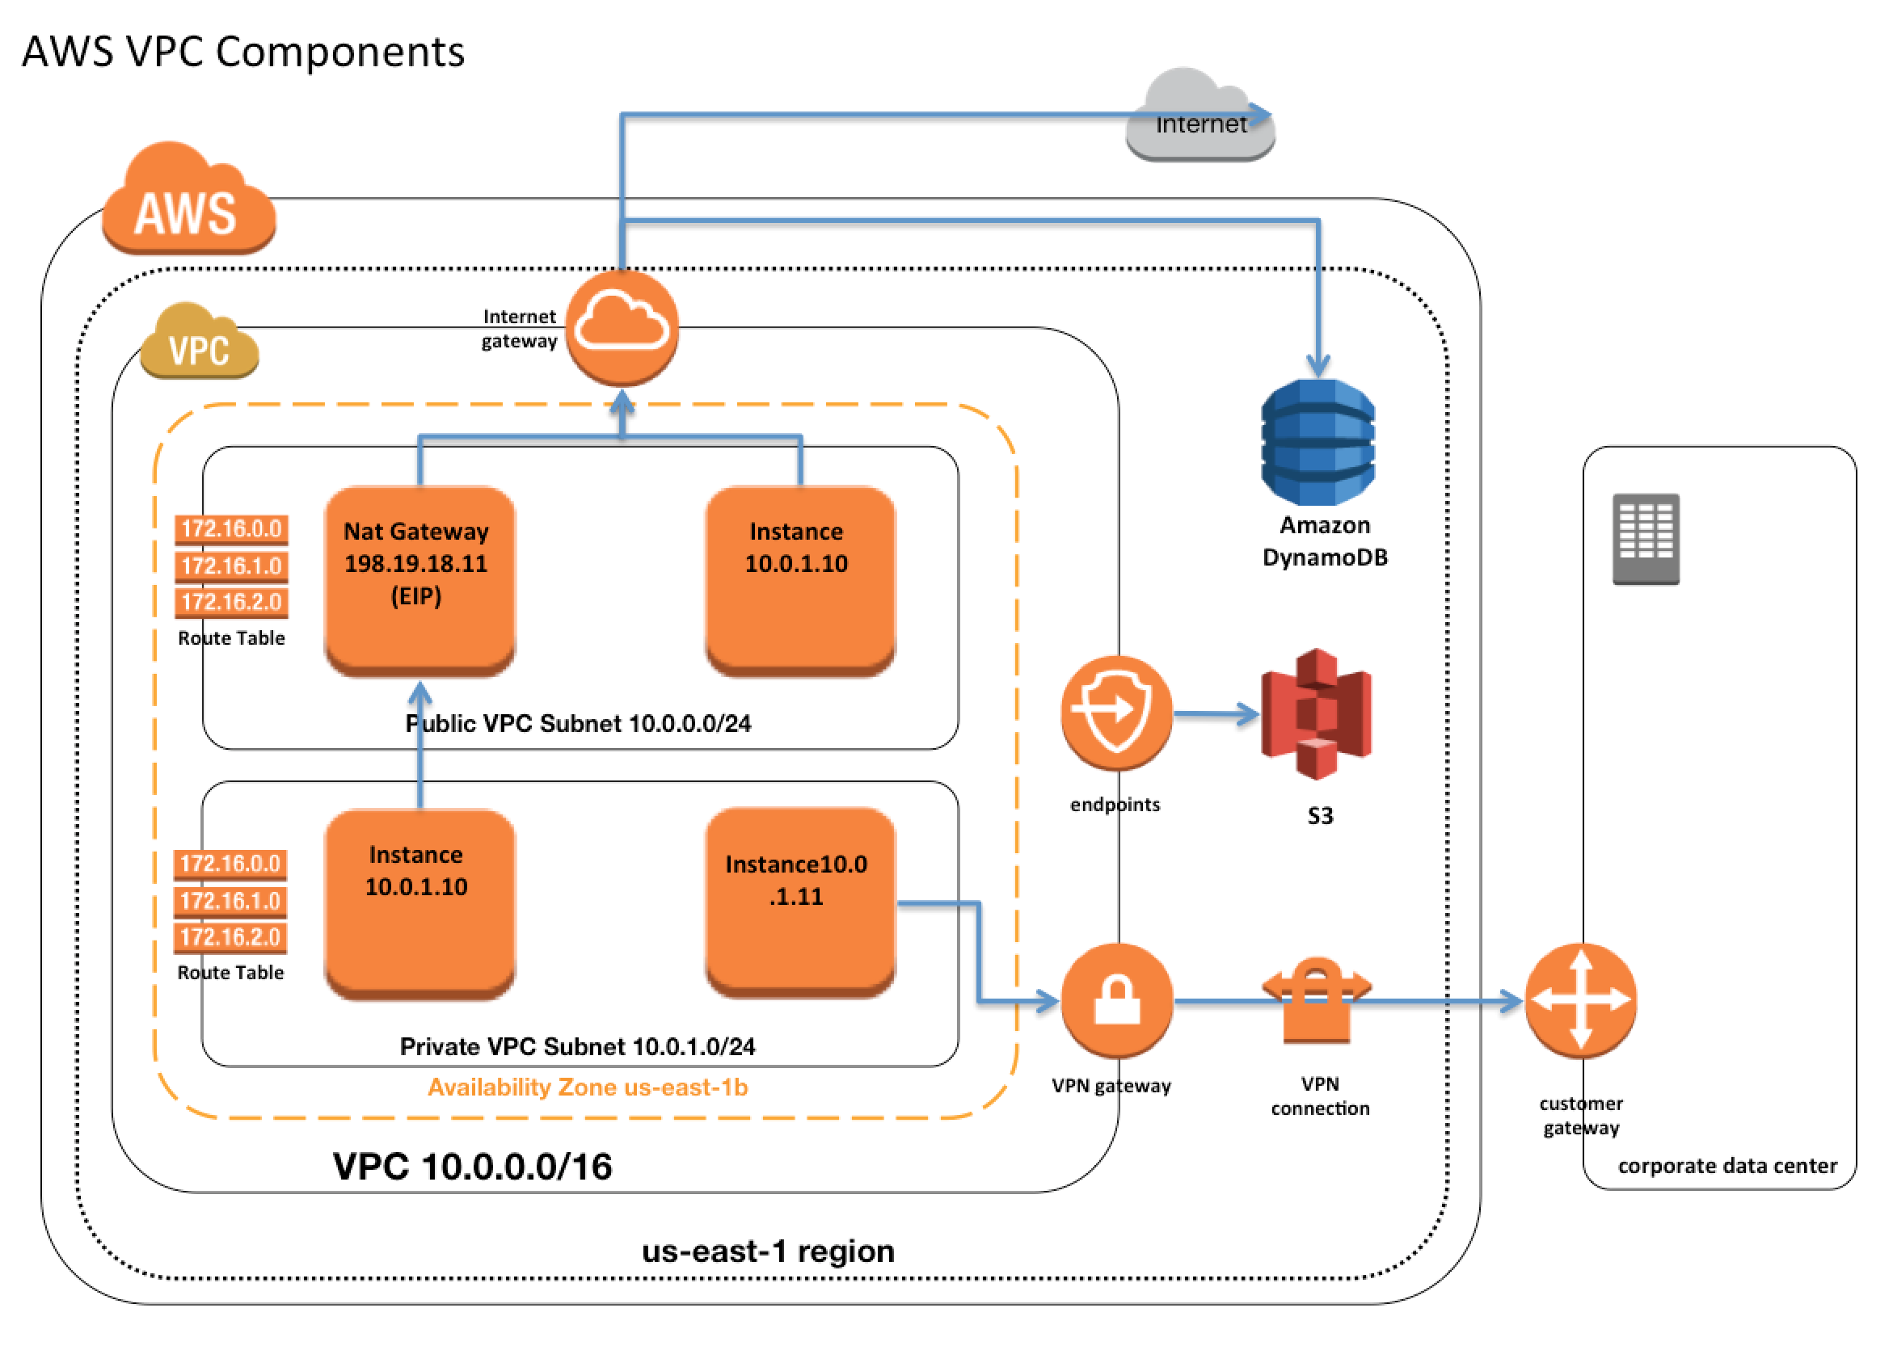
Virtual Private Cloud (VPC) VPC Sample Architecture
CIDR.xyz

Slide 4
Virtual Private Cloud (VPC) LAB - 1
Create a custom VPC
Go to VPC Dashboard
Click on Your VPCs in the left panel
Then click on Create a VPC
Give a name
Select a CIDR address range, use 10.0.0.0/16
Enable IPv^6 CIDR block
Tenancy leave as default, DO NOT SELECT DEDICATED
Create a subnet
Click on subnets on the left panel
Click on Create subnet
Give a name
Select the VPC just created
Select an availability zone
Enter the CIDR block, use 10.0.1.0/24
In IPv6 CDR Block, select don’t assign a IPv6 CIDR
Create another subnet in a different AZ with CIDR 10.0.2.0/24
Next add an Internet gateway, go to Internet Gateways
Click on Create Internet gateway
Give a name
Attach it to a VPC
Next, create a route table, click on create Route Table
Give name
Attach it to the VPC created
Go to Routes in the panel at bottom, Click on edit
Add another route, 0.0.0.0/0 to the internet gateway
Go to Subnet associations, click edit
Select the first subnet , this makes it the public subnet
Enable auto-assignment of Public IP in public subnet via Subnet actions
Add an EC2 instance in each of the two subnets
SSH into the public server
Try pinging the private server

Slide 5
Virtual Private Cloud (VPC) LAB - 2
Rename the private server to DB Server
Create a new Security Group, name is RDS –SG
Open ports to SSH, MySQL, HTTP and HTTPS
In the source, keep the subnet for Public Server, 10.0.1.0/24
Change the Security group of the DB server to the RDS-SG security group
SSH into public server
Try pinging the private server
Create a copy of the Private Key on the server
Try SSH into the private server using private IP
Try to check if internet access is enabled
Make the server internet accessible
Create a NAT Instance
Add routing table to configure a rule from Private Subnet to NAT Instance
Check Internet accessibility
Create a NAT Gateway
Add a routing table to configure rule from Private Subnet to NAT Gateway
Check internet accessibilty

Slide 6
Virtual Private Cloud (VPC) LAB - 3

Slide 7
Virtual Private Cloud (VPC) LAB - 3
Create a new NACL
Give it a name
Attach it to the custom VPC
By Default all rules are deny
Create a webserver
Start httpd
Go to webroot
Do chkconfig httpd on
Create an index.html file
Test the webserver
Go to the new NACL
Create 3 new inbound rules to allow port 80, 443, and 22 from anywhere
Create 2 new outbound rules to allow port 80 and 443 from anywhere
Create 1 more outbound rule , custom TCP rule, to allow all ephemeral ports (1024-65535) from anywhere
Associate it with the public subnet
A subnet can only be associated with one NACL
Check if webpage is working
Now add a rule to deny HTTP from your IP address
First give the rule name higher than default
Then higher than default

Slide 8
Virtual Private Cloud (VPC) Things to Remember
VPC is composed of Internet Gateways, or Virtual Private Gateways, Route Tables, NACL, Subnets, and Security Group
One subnet can only exist in one availability zone and not span across Azs
Security groups cannot span VPCs, but only subnets/AZs
The largest size of IPs in a subnet is /16, or 65,536 IPs
The smallest IP range possible is /28, or 16 IPs
There is a soft limit of 5 VPC per region
Maximum of 1 Internet gateway per VPC
VPCs can be peered with other AWS accounts as well
Peering works only in a mesh configuration, i.e. it is not transitive
Security Groups are stateful, Network Access Control Lists are Stateless
The first four IP addresses and the last IP address in each subnet CIDR block are reserved by AWS and cannot be used
VPC automatically comes with a default NACL, and allows all inbound and outbound traffic
Custom NACLs by default deny all inbound and outbound traffic
Each subnet must be associated with a NACL, if not explicitly associated it associates with the default NACL
Each subnet can be associated with only one NACL. A NACL can be associated with multiple subnets.
NACL can span AZ, subnet cannot
NACLs are evaluated as a numbered list with lower value first
NACL rules are stateless
NACLs can be used to block IP addresses, unlike security groups

Slide 9
Virtual Private Cloud (VPC) LAB - 4
Create a application load balancer
In Availability zones select the custom VPC
It requires two public facing subnets
Selecting both will give an error
Selecting one with give an error

Slide 10
Virtual Private Cloud (VPC) LAB - 5
Create a flow log
To go the VPC console
Actions -> create a flow log
Filter – All
Role – setup permissions
Goto CloudWatch
Logs -> create log group
Give the new log group name
Create flow log

Slide 11
Virtual Private Cloud (VPC) Bastion Servers

Slide 12
Virtual Private Cloud (VPC) LAB - 6
Create VPC Endpoint
Go to IAM
Create a role, select EC2
Add S3 Admin Full access
Create the role
Go to EC2
Go to the private server
Actions -> Attach replace IAM role
Go to VPC -> NACL
Change the public subnet association to the default NACL
Login to the Public instance
Login into the private instance
Run AWS S3 ls
Delete the NAT gateway route table (to stop traffic from going to internet)
Run AWS S3 ls
Go to VPC -> endpoint
Create endpoint
Select AWS S3 gateway
Select custom VPC
Select the main Route Table
Provide Full Access Policy
Go to through table, a new route has been added
Run AWS S3 ls

